Slide 1
Challenger Learning Center

Slide 2
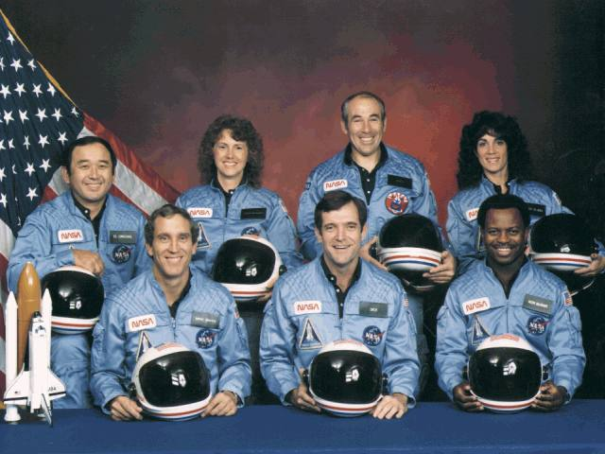
Challenger Tragedy
Francis Scobee, Michael
Smith, Ronald McNair, Ellison
Onizuka, Judith Resnik,
Gregory Jarvis, and Christa
McAuliffe
First time a teacher was on
board the Space Shuttle.
Christa McAuliffe
Second row – second
from the left

Slide 3
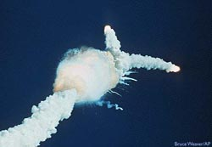
Challenger Tragedy
Challenger exploded 73
seconds after launch.
There were no survivors.

Slide 4
Challenger Learning Center
“The history of Challenger Learning Centers began in January 28, 1986, when seven crew members of the space shuttle Challenger set out on a mission to broaden educational horizons and promote the advance of scientific knowledge. Approximately 70 seconds after lift-off, an explosion took place and the entire crew was lost. In the aftermath of the Challenger accident, the crew’s families came together, still grieving from loss, but firmly committed to the belief that they must carry on the spirit of their loved ones by continuing the Challenger crew’s educational mission.”

Slide 5
Rendezvous with a Comet

Slide 6
Comets: Facts, Myths, and Legends

Slide 7
History of Comets
Comet comes from the Greek word “hair”.
Ancient Greeks thought comets were stars with long, flowing hair.

Slide 8
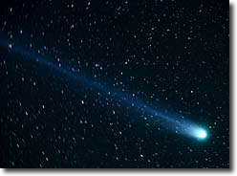
Dirty Snowballs
Comets are dusty chunks of ice and rock
During each orbit
around the sun they partially vaporize
Have elliptical orbits

Slide 9
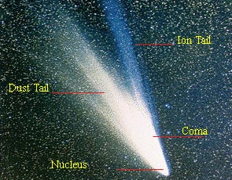
Parts of the Comet
Coma - mixture dense clouds of water, carbon dioxide and other neutral gases
Tail
Dust tail
Ion tail
Nucleus – surrounded by the coma
Notes:
A dust tail, which is usually yellow, contains small, solid particles that are about the same size as those found in cigarette smoke. This tail forms because sunlight acts on these small particles, gently pushing them away from the comet's nucleus. . Because the pressure from sunlight is relatively weak, the dust particles end up forming a diffuse, curved tail. A gas ion tail, which is usually blue, forms when ultraviolet sunlight rips one or more electrons from gas atoms in the coma making them into ions (a process called ionization). A solar wind then carries these ions straight outward away from the Sun. The resulting tail is straighter and narrower. Both types of tails may extend millions of kilometers into space

Slide 10
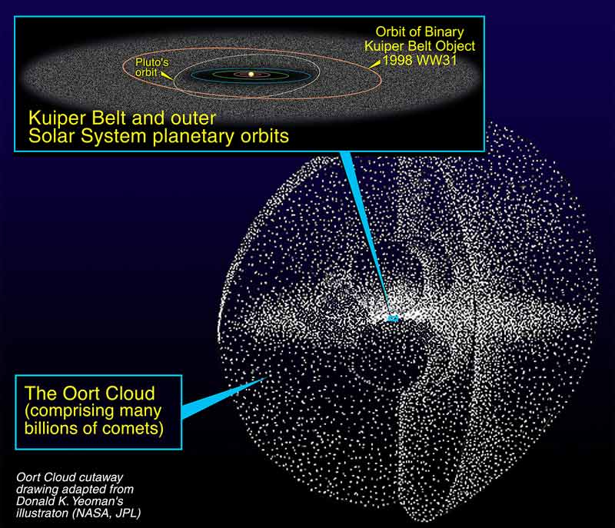
Possible Homes for Comets
Kuiper Belt
Oort Cloud
Courtesy - Deep Impact - NASA - JPL

Slide 11
Kuiper Belt
Discovered by Gerard Kuiper in 1951
Origin of short-period comets that spend less than 200 years in its orbit.
A flat disc shaped region past the orbit of Neptune.
Probably contains more than 100,000 objects
Some of these objects are 100 km or larger in diameter
Notes:
Earth is 12,756 km in diameter
AU = Astronomical units One AU equals the average distance between the center of Earth and the center of the Sun.
It would take 100 years to go 1 AU if you were traveling 100 mph.

Slide 12
Oort Cloud
Hypothesized by a Dutch Astronomer Jan Oort in 1950.
Source of long-period comets with returns ranging from 200 years to once every million years.
Shape is spherical distribution around the Sun.
19 trillion miles from the Sun.
May contain 5 trillion objects.
Probably created 4.6 billion years ago.

Slide 13
Orbits of Comets
Elliptical in Shape
Randomly oriented
Aphelion distance
Comet
Sun
Earth
Perihelion distance
Notes:
Planets have nearly circular orbits, whereas comets have elongated paths around the Sun. A comet is at aphelion when its orbit is farthest from the Sun. It is at perihelion when it is closest to the Sun. Due to gravitational effects, a comet will travel fastest at perihelion and will slow down as it approaches aphelion. Comets can be classified by their orbital period: that is, the time it takes them to make one complete trip around the Sun.

Slide 14
Life of a Comet

Slide 15
Famous Comets
Comet | Discovered | Next Visit | Noteworthy
Hale – Bopp | 1995, Alan Hale and Thomas Bopp | 2,400 years | Was seen for 19 months with the naked eye.
Swift – Tuttle | 1862, Lewis Swift and Horace Tuttle | Every 120 years | Produces the Perseid meteor showers in July and August.
Hyakutake | 1996, Yuji Hyakutake | 14,000 years | Longest comet tail ever seen.
Halley | Edmund Halley | 76 years; next viewing 2061 | Produces the Orionid meteor shower.
Shoemaker – Levy 9 | 1993, Carolyn and Eugene Shoemaker, and David Levy | Destroyed | This comet shattered in Jupiter’s gravity in 1994.
Tempel – Tuttle | 1865 – 1866, Ernst Tempel and Horace Tuttle | 2031 | Produces Leonid meteor shower.
Tempel 1 | 1867, Ernst Tempel | 5 ½ years | In July 2005, the Deep Impact spacecraft collided with this comet to study it. Found water ice on the surface.

Slide 16
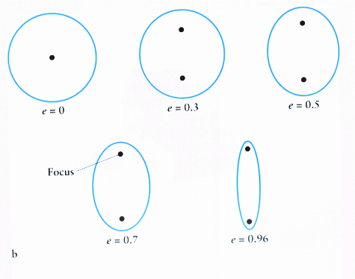
Eccentricity of a Comet
Describes the shape
of an orbit
0 = a circle
1 = an oval
Comets’ orbits are
closer to a 1

Slide 17
Magnitude
The brightness of a comet or other object.
Sun = -26
Full moon = -13
Comets = 7
Stars = 4

