Slide 1
Chapter 14 Notes

Slide 2
Forms of Energy
Ability to do work or cause a change
Change an objects motion, color, shape, temperature, or other quality
Types
Sound
Light
Electrical
Magnetic
Chemical
Nuclear

Slide 3
Energy Moves and Changes
Law of Conservation of Energy
Energy cannot be created or destroyed.
Can move from one object to another
Can change from one form to another
Every time energy changes form, some energy is given off as unusable heat.

Slide 4
Energy Moves and Changes
Someone lights the firework.
Chemical reactions create hot gases.
Fireworks cannot hold the expanding gases, and they explode.
Energy changes to light energy, thermal energy and sound energy.
Notes:
Discuss how radios are electrical energy to sound energy – TEST QUESTION

Slide 5
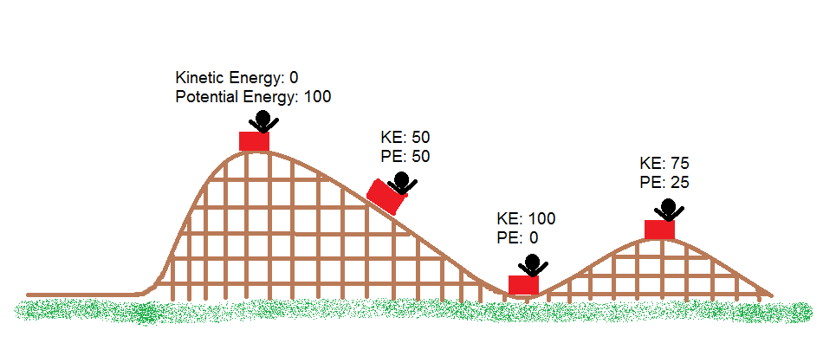
Kinetic Energy
Energy due to motion
The amount of kinetic energy in an object depends on the speed and mass
Basketballs have more kinetic energy than marbles

Slide 6
Potential Energy
Stored energy
Often changes to kinetic energy
Let’s sing!
Pic linked
Notes:
Youtube video
Cup rocket launch activity – demonstration
It’s a Stretch – student exploration

Slide 7
Chemical Energy
Potential energy
Energy of the electrons that form the bonds between atoms in a molecule
Match – changes chemical energy changes to light and heat energy
Notes:
Is it hot in here – student exploration

Slide 8
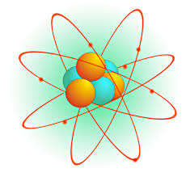
Nuclear Energy
Potential energy
It is the bond holding the proton in place
Something can knock a proton out of the nucleus
Produces electrical energy

Slide 9
Sound Energy
A wave of vibrations that spreads from its source
Sound travels in waves
The more energy a wave has, the louder the sound will be

Slide 10
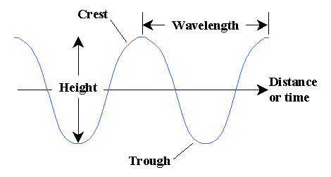
Sound Energy
Crest – particles are very close together
Trough – particles are spread out
Wavelength – number of crests that pass by a point each second

Slide 11
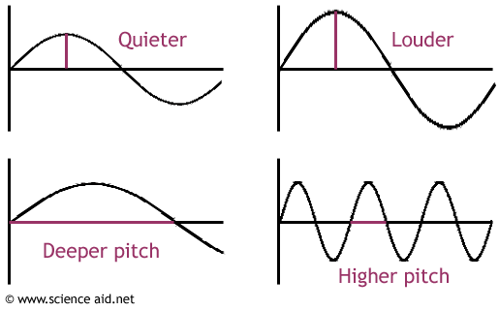
Sound Energy
Notes:
Greater frequency = higher pitch
Demonstrate with a slinky
Exploring Sound – student exploration

Slide 12
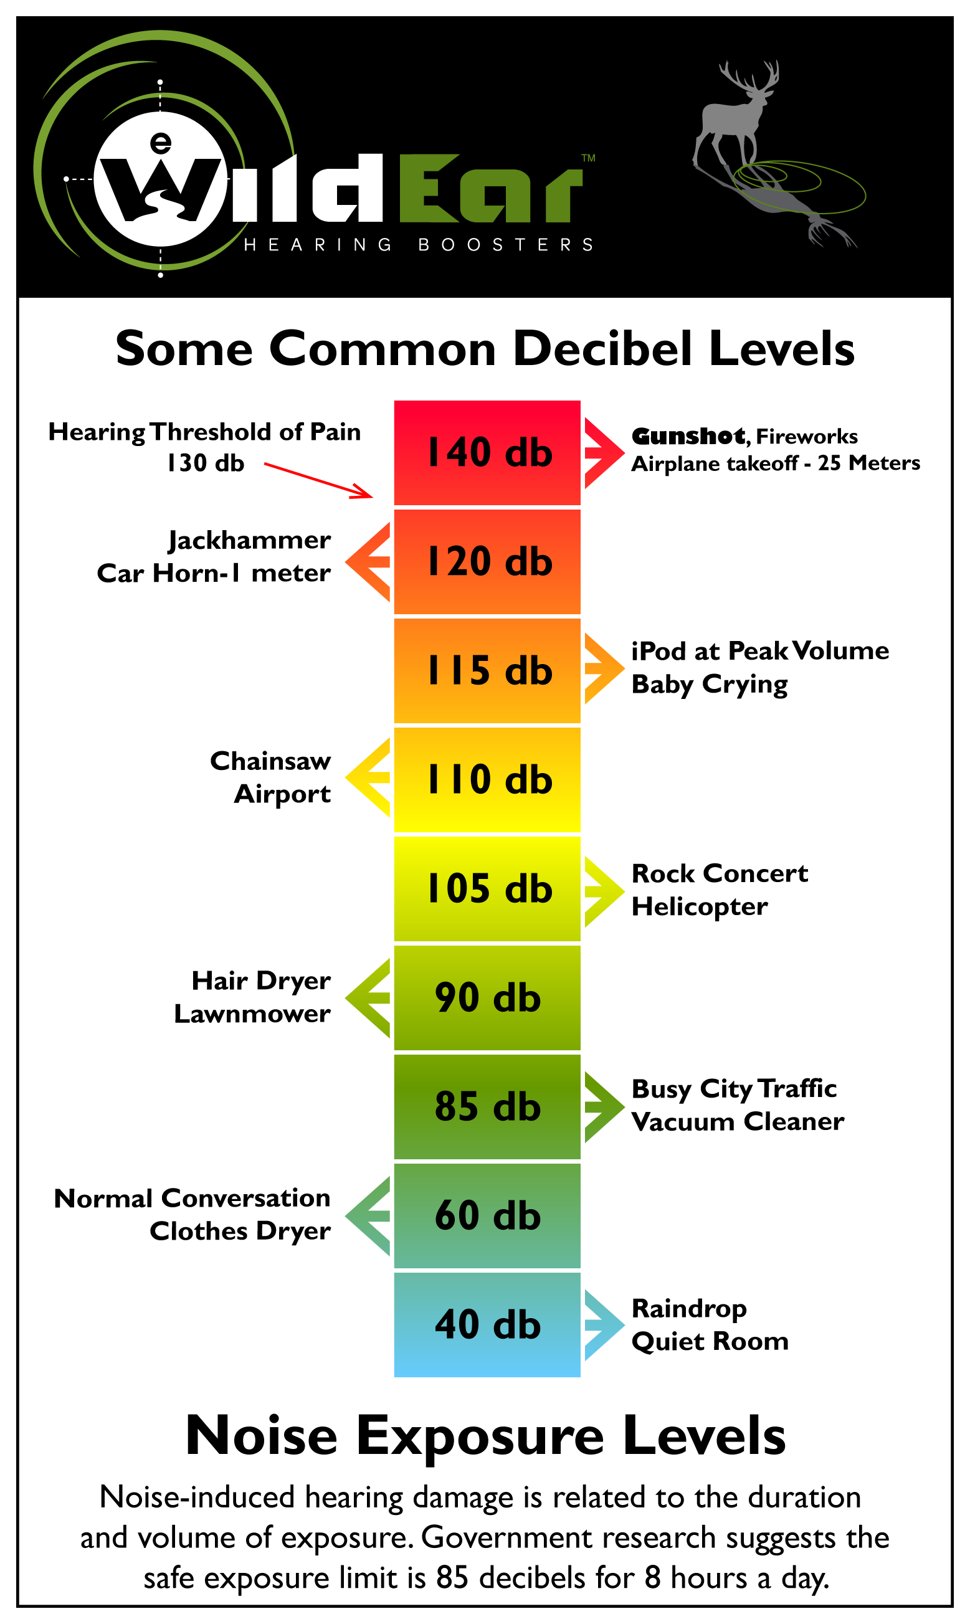
Sound Energy
Sound’s loudness is measured in decibels.

Slide 13
How Sound Behaves
Sound can travel through solids, liquids and gases
Sound travels at different speeds in different materials
Move slowest through air!
Let’s have Bill Nye explain sound waves to us!
Notes:
Sound Through Solids – student exploration

Slide 14
Light Energy
Light is a form of energy that travels in waves
Light is a form of electromagnetic radiation
The spectrum has many frequencies and wavelengths
Different wavelengths of visible radiation are seen as different colors.

Slide 15
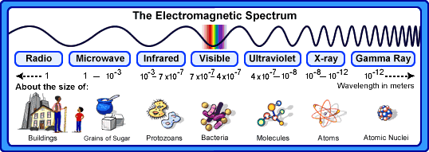
Light Energy

Slide 16
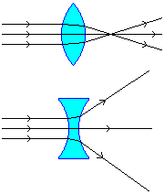
Light Energy
Convex – thickest in the middle
Makes an object look larger
Bend and focus on a point
Concave – thinner in the middle than the edges
Makes an object look smaller
Bill Nye “Light and Color”
Notes:
https://www.youtube.com/watch?v=YNE6zeLqEyU

Slide 17
Thermal Energy
The total of all the kinetic and potential energy of the atoms of an object.
A change in thermal energy can lead to a change in phase.
Temperature is the measure of thermal energy

Slide 18
Thermal Energy
Thermal energy flows between materials that have different temperatures.
Warmer to cooler objects
Bill Nye!

Slide 19
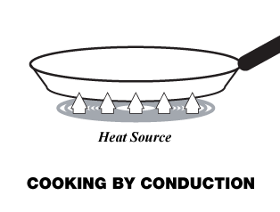
Thermal Energy
Conduction – transfer of heat between objects that are in contact.

Slide 20
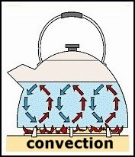
Thermal Energy
Convection – transfer of heat by moving liquid or gas.

Slide 21
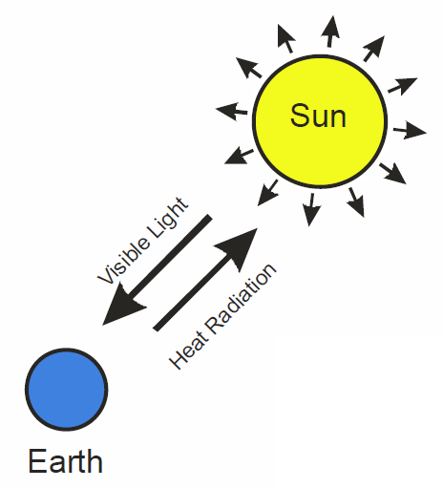
Thermal Energy
Radiation – transfer of heat by electromagnetic waves.

Slide 22
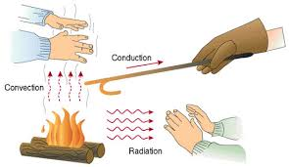
Thermal Energy
3 Types of Heat Transfer
Pic linked
Notes:
Song!

