Slide 1
Chapter 11
Matter and its Properties

Slide 2
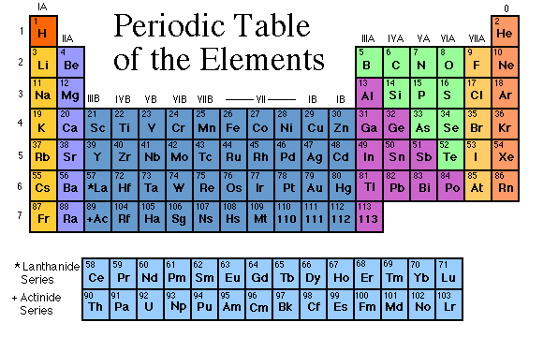
Elements
The basic building blocks of matter.
Over 100 basic kinds of matter.
Elements combine to make up all other kinds of matter.

Slide 3
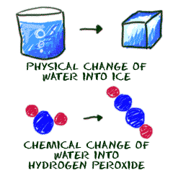
Properties of elements
Physical
Can be measured without changing the material
Color, odor, mass, volume, phase at room temperature
Chemical
How materials change into other materials

Slide 4
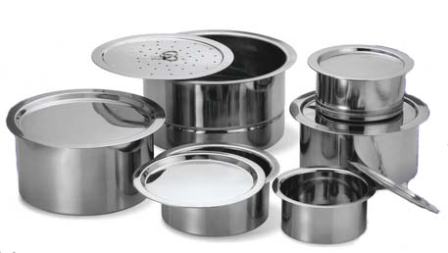
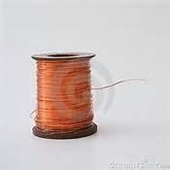
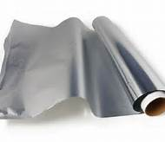
Properties of elements
¾ of the elements are metals.
Physical properties of metals are:
Shiny,
Bendable
Able to conduct heat
Able to conduct electricity

Slide 5
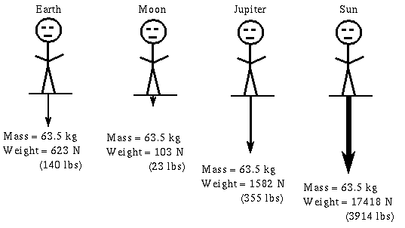
Weight and mass
Weight
The measure of the pull of gravity on an object.
Can change when the pull of gravity changes.
Measured in pounds
Mass
The amount of matter in an object.
Does not change
Measured in grams
Weight vs. Mass
A delightful song!

Slide 6
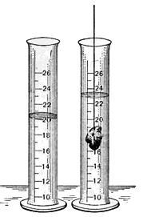
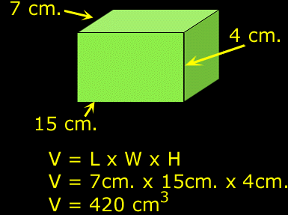
Volume
The amount of space that an object takes up.
Measured in cubic units
Volume song!!

Slide 7
Density
Density
The measure of the amount of matter in a given volume.
Density = mass / volume
Another little song!

Slide 8
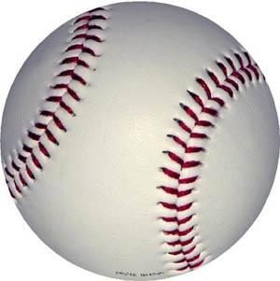
Density
Baseball
Mass = 110 g
Volume = 195 cubic cm
Density = 0.56 grams/cubic cm
Ball of Clay
Mass = 445 g
Volume = 195 cubic cm
Density = 2.28 grams/cubic cm
Notes:
Make a density tower

Slide 9
Buoyancy
An object is buoyant if it floats
If the object’s density is less than the liquid’s density, it will float.
If the object’s density is greater than the liquid’s density, it will sink.
Density of fresh water = 1.00 grams/cubic cm.
Density of a tennis ball = 0.29 grams/cubic cm.
Density of a baseball = 0.56 grams/ cubic cm.
Which one will float?
Which one will sink?
Buoyancy Video

Slide 10
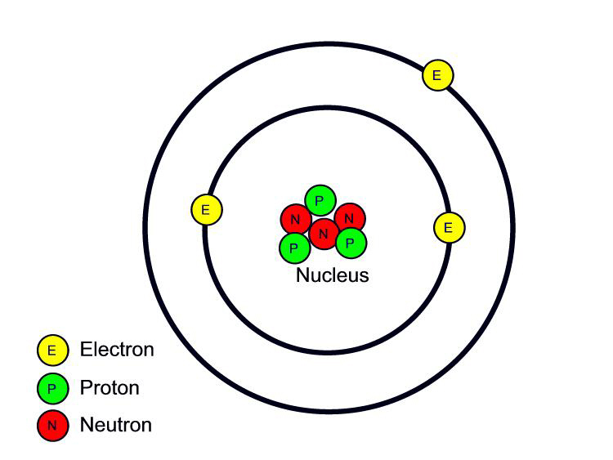
Atom
The smallest particle of an element that still has the properties of the element.
Made up of:
Protons: positive charge
Found in the nucleus
Neutrons: no charge
Found in the nucleus
Electrons: negative charge
Move around the nucleus
Can join or leave the atom
Can be shared with another
atom

Slide 11
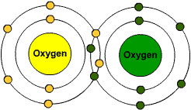
Molecule
The smallest particle of a substance made of combined atoms
An oxygen molecule has two atoms

Slide 12
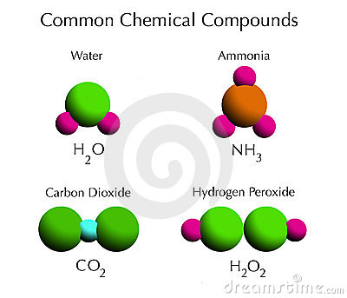
Compounds
A type of matter made of a combination of different elements.
Most things that you see around you are compounds.

Slide 13
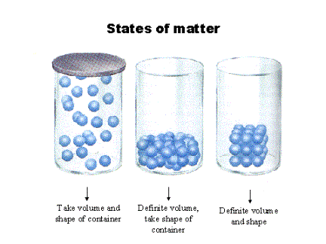
Phases of matter
Solids
Have a definite shape and volume.
Particles are very close together
Particles move quickly

Slide 14
Phases of matter
Liquid
Have a definite volume
Particles are fairly close together
Do not have their own shape.
Take the shape of the container they are in.

Slide 15
Phases of matter
Gas
Particles are not close together
Particles float around – sometimes colliding into each other
No definite shape or volume.

Slide 16
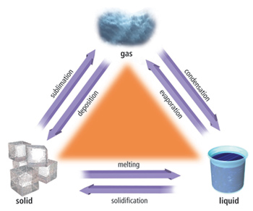
Changes of matter
Liquid to Solid – Freezing Point
When a liquid gets colder, it freezes.
Particles slow down
Water freezes at 0 degrees Celsius (32 degrees Fahrenheit)

Slide 17
Changes of matter
Liquid to Gas – Evaporation/Boiling
When a liquid gets hotter it starts to boil.
Particles evaporate from the surface of a liquid when they move upward with enough speed.
Different liquids have different boiling points.

Slide 18
Changes of matter
Gas to a Liquid - Condensation
Often happens when gas particles touch a cold surface and their temperature drops.
Particles slow down and get trapped.
As more particles get trapped, they form a liquid drop.

Slide 19
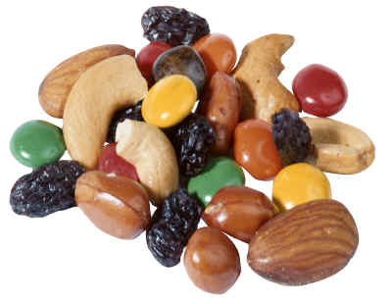
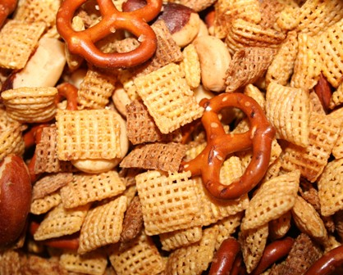
MIXTURES
Different materials placed together but do not bond to form compounds.
The different materials keep their properties.
The materials can be separated out.

Slide 20
SOLUTIONS
A special mixture in which substances are spread out evenly and will not settle.
Solute = substance being dissolved
Solvent = substance doing the dissolving.
Solute = sugar
Solvent = water

Slide 21
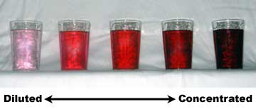
SOLUTIONS
Concentrated Solution – has so much solute that it is relatively close to being saturated
Dilute Solution – just a little solute in comparison with how much could dissolve.

Slide 22
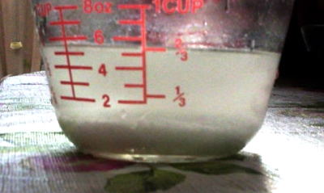
SOLUTIONS
Saturated Solution – contains all the solute that can be dissolved without changing the temperature
Once it has reached it’s limit of solute it is called saturated
If you add more solute to a saturated solution, the extra solute will settle to the bottom.

