Slide 1
Chapter 5
America Grows and Changes

Slide 2
Lesson 4
Progressives and reform

Slide 3
Progressives
Wanted to cause changes to help others
Economic changes
State government changes
Federal government changes

Slide 4
City Reform
Many political bosses (elected official, like mayor, who is corrupt
Commission government – special committee
Each member was in charge of one part of government

Slide 5
State Reform
Candidates for governor were chosen by their political party
Wisconsin governor, Robert M. La Follette, changed it to a direct vote system
People chosen based on merit
Labor Laws
Shorten workday to a maximum of 10 hours
Child labor laws – certain jobs children cannot do
State would pay injured workers while they couldn’t work

Slide 6
The Square Deal
President Roosevelt – strong progressive
Wanted to make sure all Americans were given the same opportunities to succeed
Broke up monopolies
Northern Securities Company (large railroad company)
John D. Rockefeller’s Standard Oil Company
Pure Food and Drug Act & Meat Inspection Act
Check food and medicine for safety
Conservation
Protecting environment and natural resources
Created many national parks

Slide 7
Other Federal Reforms
Sixteenth Amendment
National income tax; previously based on property only
Seventeenth Amendment
People elected senators instead of the state legislature

Slide 8
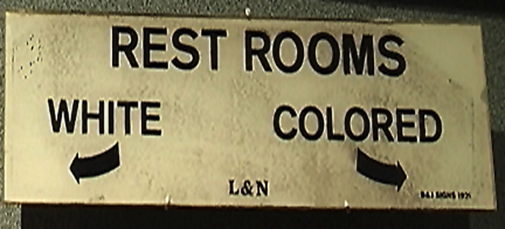
Early Civil Rights
Rights guaranteed to all citizens by the Constitution
African-Americans still segregated, especially in the south (Jim Crow laws)
NAACP – worked to change state laws to give full civil rights to African Americans and other minority groups
National Urban League – purpose to help African Americans find jobs and housing

Slide 9
Improving Society
Child Labor Laws
Children working to help the family survive
Laws passed to keep children from dangerous jobs
Children required to go to school
Prohibition
Believed that alcoholic beverages were the cause of many problems in the US
Stop (prohibit) people from drinking alcoholic beverages
Worked to pass an amendment prohibiting the making and selling of alcoholic beverages

Slide 10
Reflection
Which reforms do you agree with? Why?
Which reforms do you disagree with? Why?

