Slide 1
Chapter 5
America Grows and Changes

Slide 2
Lesson 3
Growth and change

Slide 3
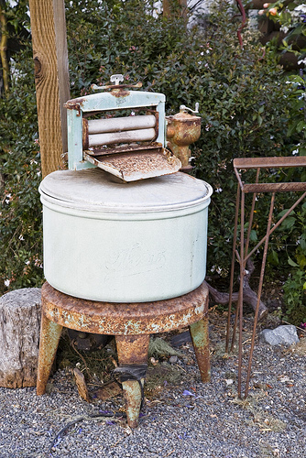
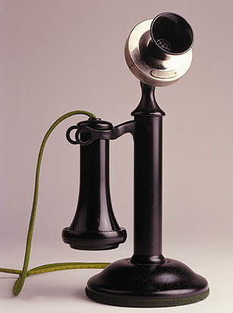
New Inventions
1876 – Alexander Graham Bell → telephone
1877 – Thomas Edison → phonograph
Could record and play back sound
1879 – Thomas Edison → light bulb

Slide 4
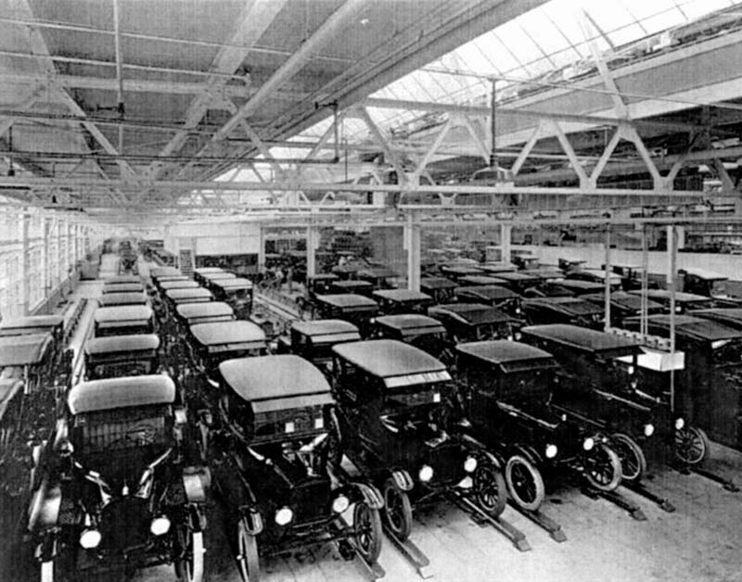
Automobiles and Highways
Made by hand – very expensive
Henry Ford: “I will build a motor car for the multitude.”
Assembly Line
Cost dropped from $950 (1908) to $290 (1927)
Increase in roads, connecting rural areas to urban areas

Slide 5
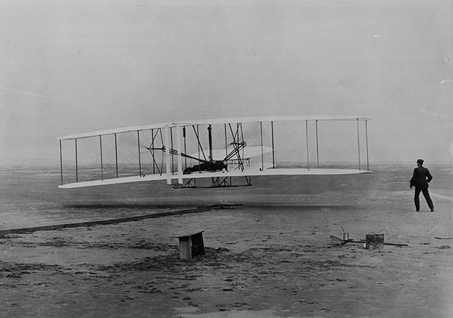
Aviation
Orville and Wilbur Wright working to improve travel
December 17, 1903 – first successful flight
12 seconds
120 feet
Few years later, Americans started building airplanes
1920s – first scheduled airlines

Slide 6
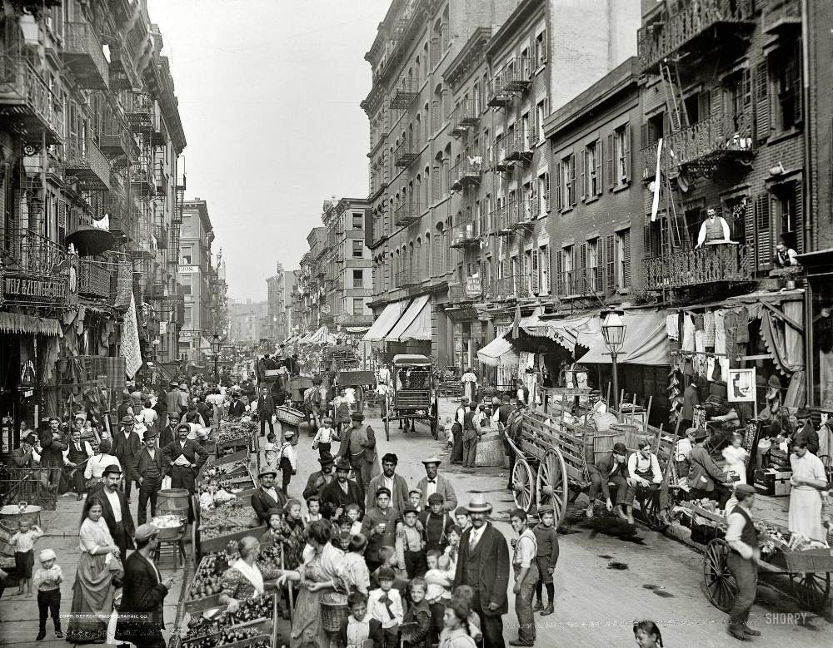
Growth of Cities
1860 – only about 1/6 of Americans lived in cities
1900 – about 1/3 of Americans lived in cities

Slide 7
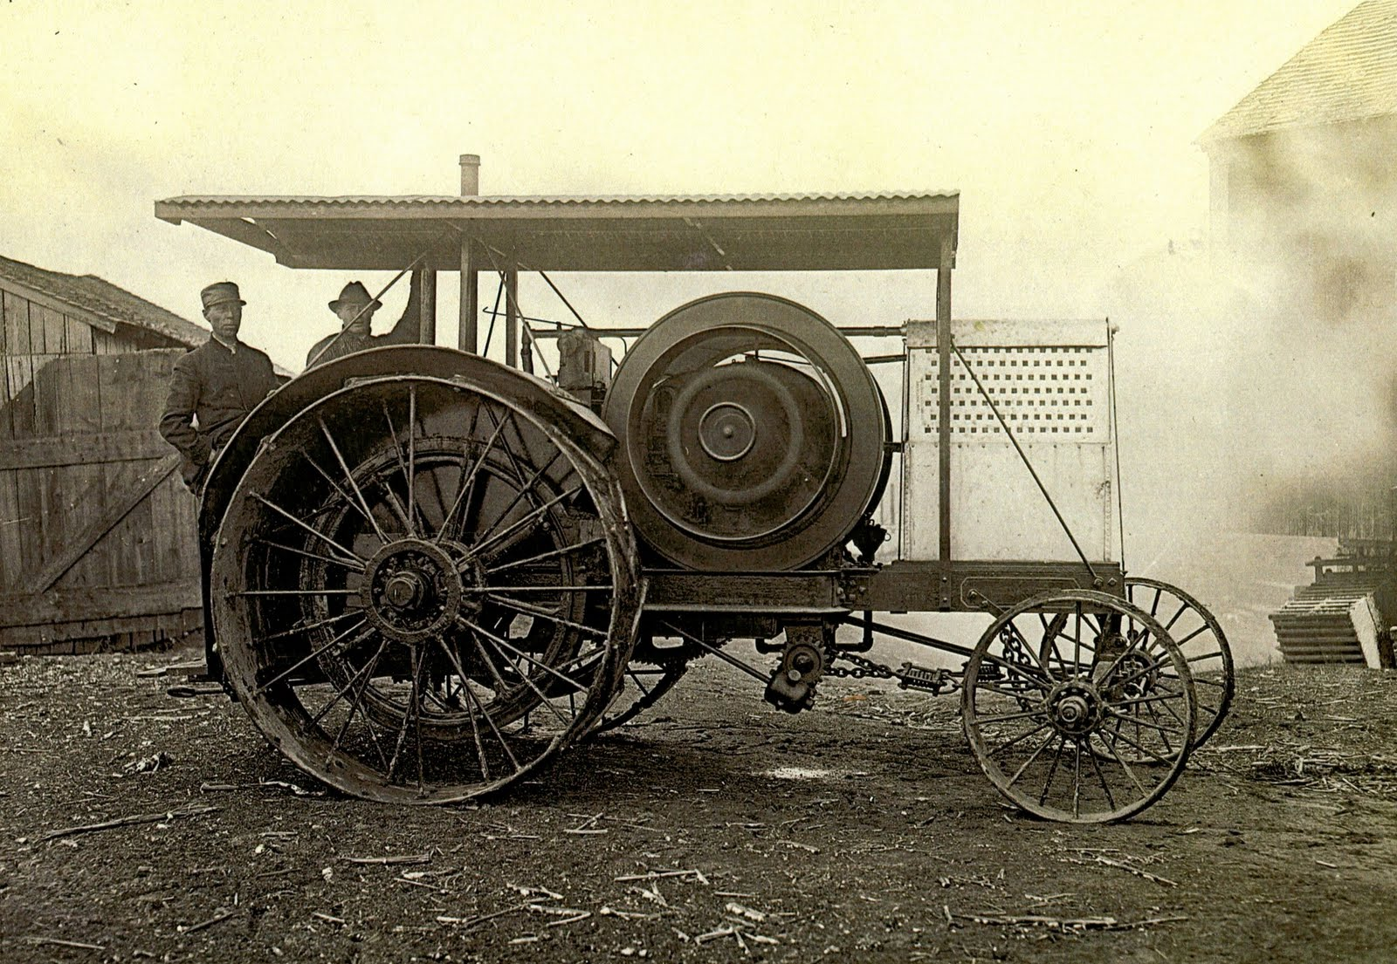
Why?
New farming machines
Farming tasks done more quickly
Needed fewer farmers

Slide 8
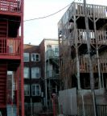
City Problems
Tenements
Disease
Trash—rats, insects
Fire
Crime
Difficult for police to find lawbreakers
Gangs
Police were afraid of some neighborhoods

Slide 9
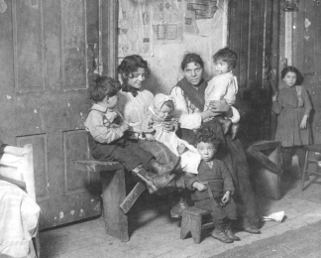
Help for the Poor
Settlement Houses – community centers where people could learn new skills
Schools: taught sewing, cooking, and English

Slide 10
Reflection
How did some of the inventions you learned about change people’s lives?

