Slide 1
Chapter 5
America Grows and Changes

Slide 2
Lesson 2
A new role for the united states

Slide 3
Imperialism
Empire-building
Many new lands – including Pacific islands
Led to conflict with European nations

Slide 4
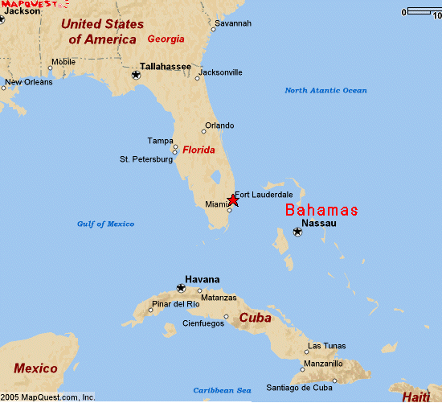
Cuba
Spain’s empire shrinking
Puerto Rico & Cuba
Many Cubans wanted independence
Many Americans supported the Cubans:
Struggle for independence was like ours
Some Americans owned plantations and mills
American newspapers said Spanish were treating Cubans badly

Slide 5
Spanish-American War
Peaceful attempt to help Cuba – offer to buy from Spain
Conflict – sent battleship to protect Americans and businesses in Cuba
Exploded on first night in harbor, killing 260 seamen
Newspapers said Spain attacked the ship
Americans demanded war – declared on April 25, 1898
Only lasted four months

Slide 6
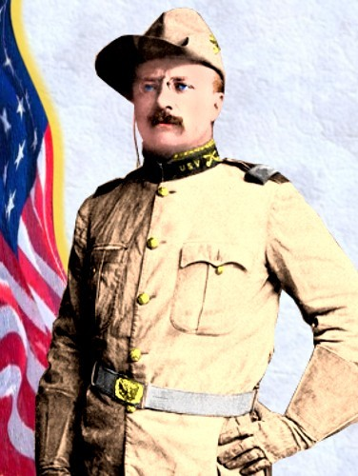
Theodore Roosevelt
War hero from Spanish-American War
Army volunteer with “Rough Riders” who were mostly western cowhands and college athletes

Slide 7
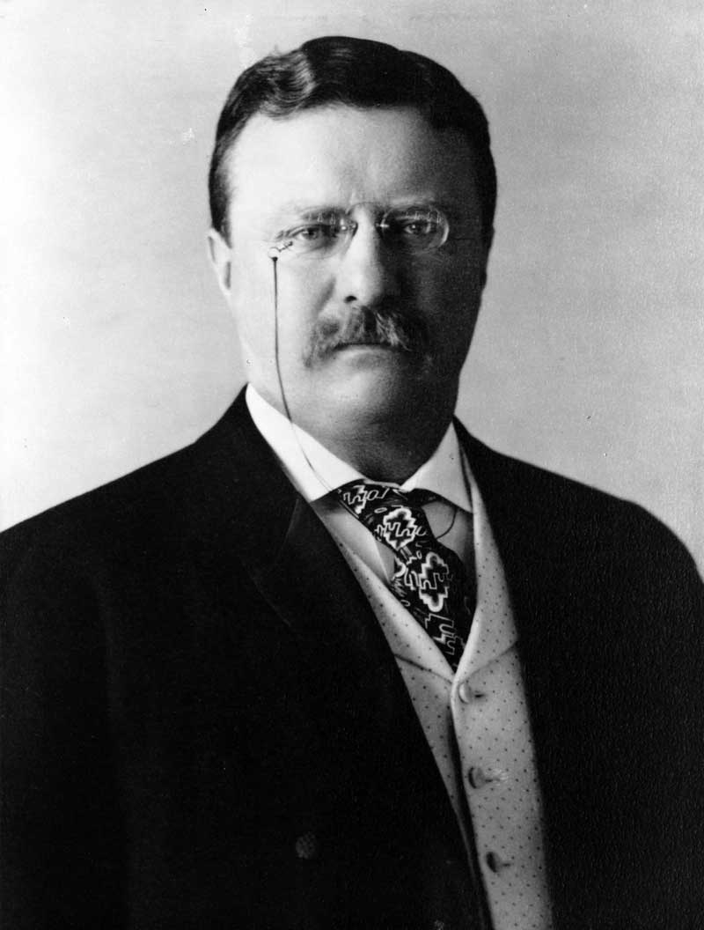
Road to the Presidency
After Cuba, elected to governor of New York
Two years later, elected Vice President, with President William McKinley
In 1901, McKinley was killed and Roosevelt became President

Slide 8
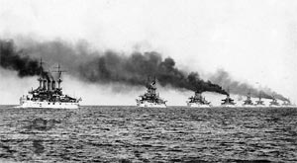
Roosevelt as President
Roosevelt believed that the U.S. should be involved in actions throughout the world.
In 1907, Roosevelt decided to remind other countries that he was the leader of a powerful military force
Sent “Great White Fleet” on a world cruise

Slide 9
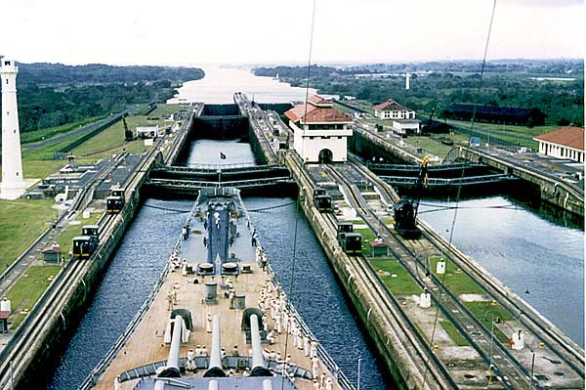
Panama Canal
The Panama Canal was built as shortcut instead of sailing around South America. Construction on the canal began in 1904. Many lives were lost to yellow fever and malaria from mosquitoes during the construction of the canal. When the Panama Canal was finished it stretched 40 miles long and cost the U.S. about $380 million dollars.
Building the Panama Canal.

Slide 10
Reflection
Do you agree with President Roosevelt’s opinion that it was important for the United States to get involved in the affairs of other nations?

