Slide 1
Chapter 5
America Grows and Changes

Slide 2
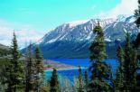
Lesson 1
New Lands for the United states

Slide 3
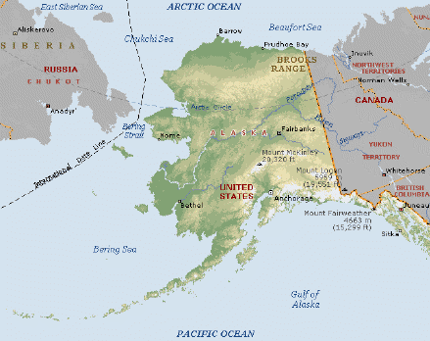
Alaska once belonged to Russia

Slide 4
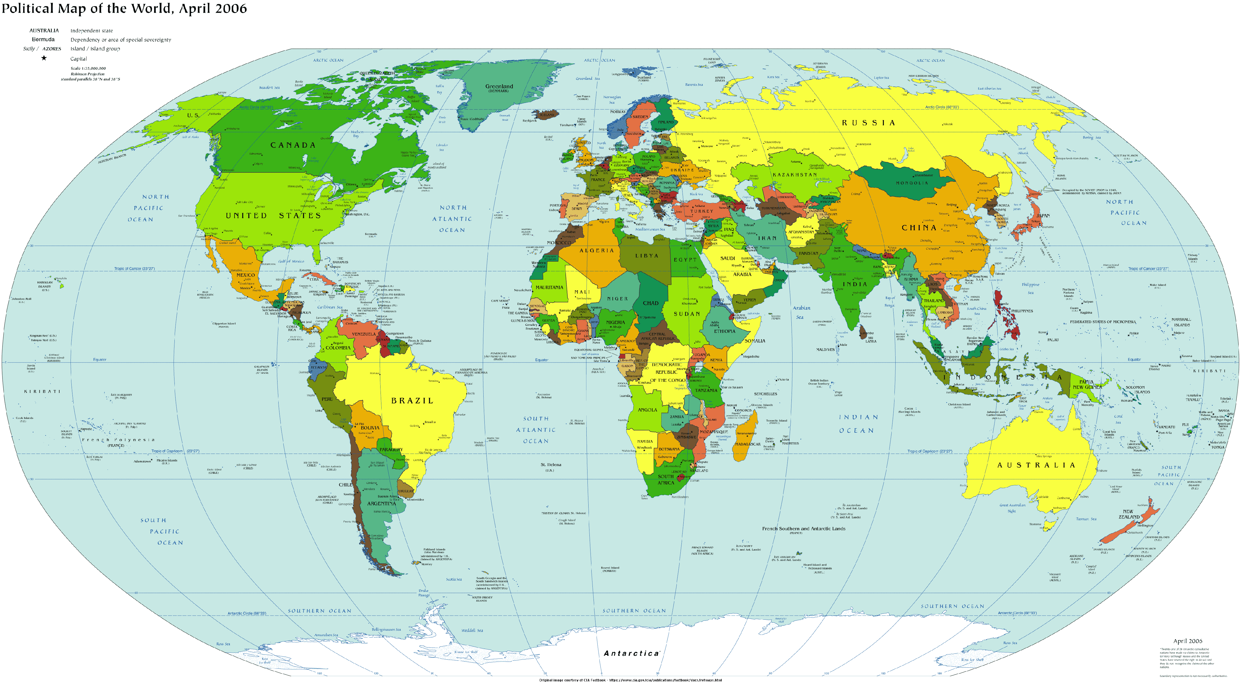
Alaska once belonged to Russia

Slide 5
Alaska
Alaska once belonged to Russia
In the late 1800s, Russia began to lose interest in the region because:
It had economic problems to worry about
Alaska would be hard to defend

Slide 6
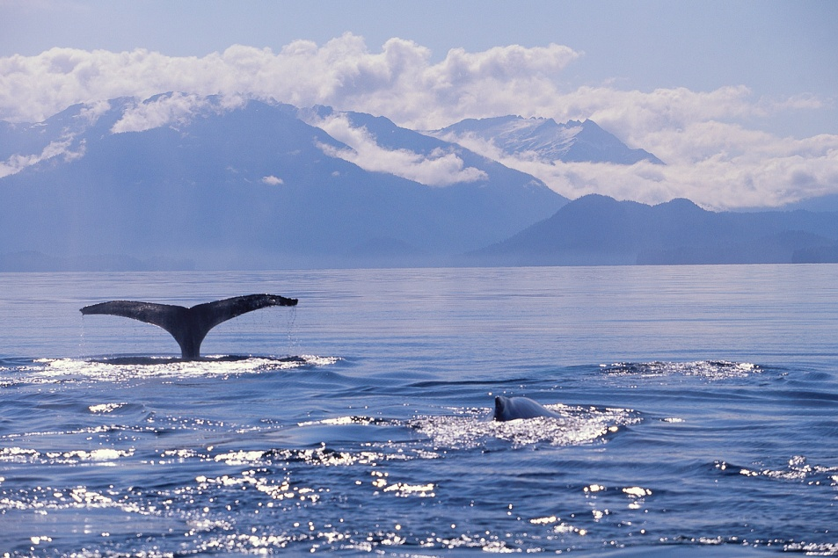
SOLD!
Russia offered to sell Alaska to the United States for $7 million dollars!
Is that a lot of money?
It was only 2 cents per acre!!!

Slide 7
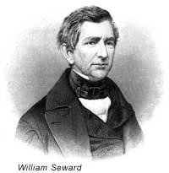
Americans’ Opinions
Many people thought that buying Alaska was a huge waste of money.
Some people liked the idea of expanding our borders.
One man who thought it was a good idea was William Seward. He was one of the men who persuaded Congress to make the purchase.
His decision to buy the land was known as “Seward’s Folly.”---A Folly is a foolish idea.

Slide 8
In 1880, gold was discovered in Alaska! Soon, many people who thought the purchase was a bad idea changed their minds. The discovery started another gold rush.

Slide 9
Valuable Land
In addition to gold, Alaska turned out to be valuable for many other reasons.
Its rich earth held deposits of valuable minerals such as: gold, silver, copper, and zinc.
Its rich waters contained many fish.
Alaska turned out to be such a great deal that many people thought the U.S. should try to ad more lands!
It became a territory in 1912.

Slide 10
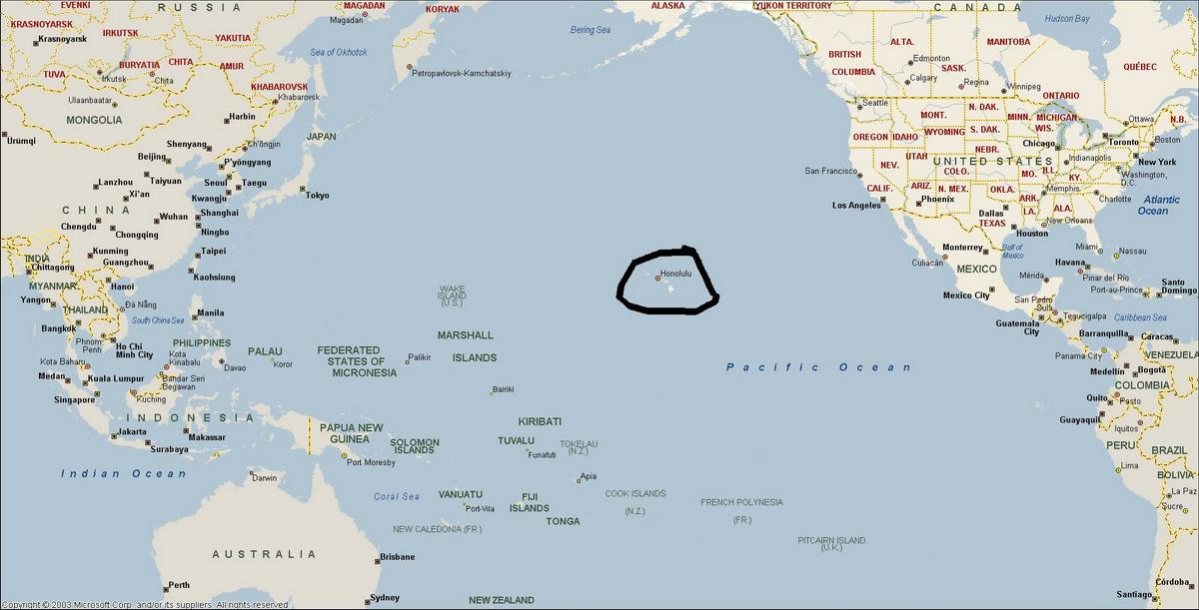
Hawaii “Gateway to the Pacific”

Slide 11
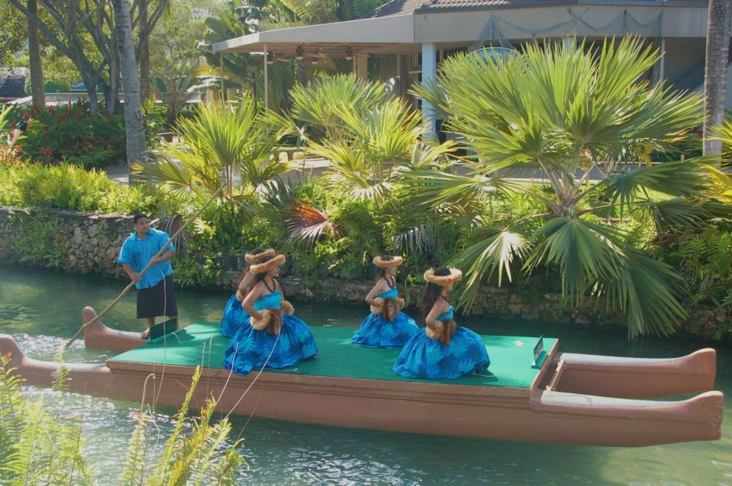
Hawaii
Polynesian people settled Hawaii in the 700s.
It was used as a stopping point for many ships making the journey across the Pacific Ocean for many years.

Slide 12
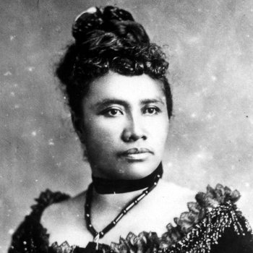
Hawaii
Christian missionaries began moving to Hawaii in the early 1800s. Their goal was to convert the Polynesians to Christianity.
Other Americans soon followed and settled on the islands.
In 1893, a group led by Americans overthrew the queen, and took over control of the islands.

Slide 13
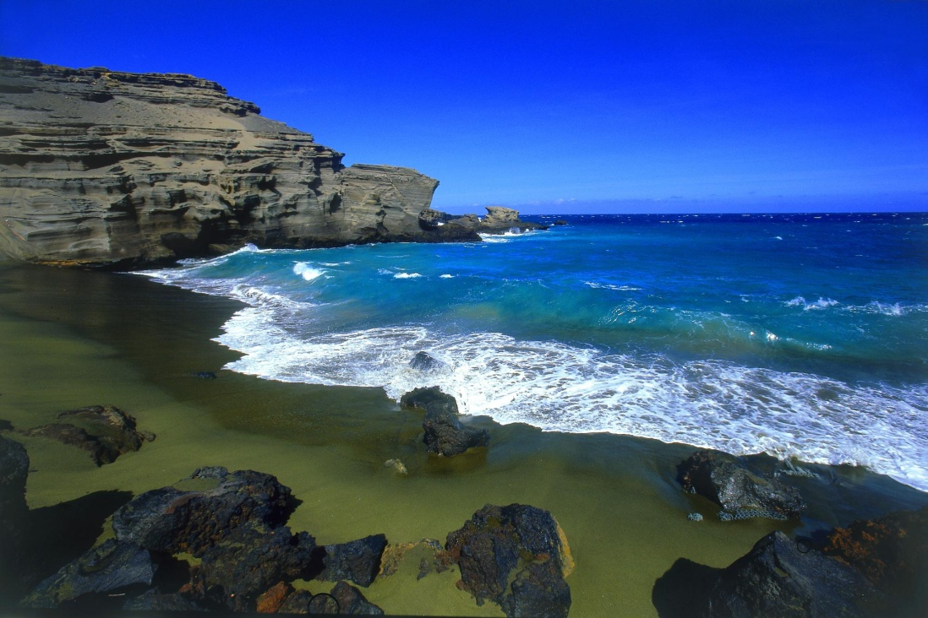
Journey to a Territory
1893 – because a United States-controlled republic
1898 – annexed into the United States
1900 – became a US territory

Slide 14
Reflection
Which territory do you think was the more valuable addition to the United States—Alaska or Hawaii? Why?

